Slide 1
Now offer the Chemical Industry
State-of-the-art Chemical Storage facility

Slide 2
About V-Trans group
30% business from Chemical Transportation
800 +
Branches
Handles 6 lakh tonnes of Chemicals annually
2 Million Tonnes
2.4 million dockets
INR 10 billion
Turnover
Key Facts
9,00,000 + sq. ft.
warehousing space
1,00,000
Satisfied customers
1300+ captive vehicles,
GPS enabled
3000 + passionate
professionals
ISO : 9001 : 2015
accreditation

Slide 3
About V-Logis
V-Logis is an essential arm of V-Trans.
It deals with warehousing & 3 PL requirements of clients.
Pan India presence in 22 cities
More than 9 LAKH sq. ft warehousing space
Over 30 % of business is through chemicals

Slide 4
Strategically located
78 kms
from JNPT Seaport
58 kms
from Sahara
International Airport
38 kms
from Thane Station
27 kms
from Kalyan Station
Strategically located close to Mumbai – Nashik highway (at Dohole village) away from residential area but within proximity of small habitat http://bit.do/ePtXj
60 kms
from Corporate
Head Office
20 kms
from Kalyan Bypass

Slide 5
Strategically located
As per norms Chem Store is located away from residential, School & River.
For commuting bus facility is provided from nearest railway station. (Khadawali – Vashind - Kalyan)
Chem Store is located at NH-3, which is 30 km from Mankoli-Bhiwandi.
A tie-up with VED Hospital for emergency services and Ambulance has been done. Hospital is 12 km from Chem Store.
Fire station is located 20 km from Chem Store.

Slide 6
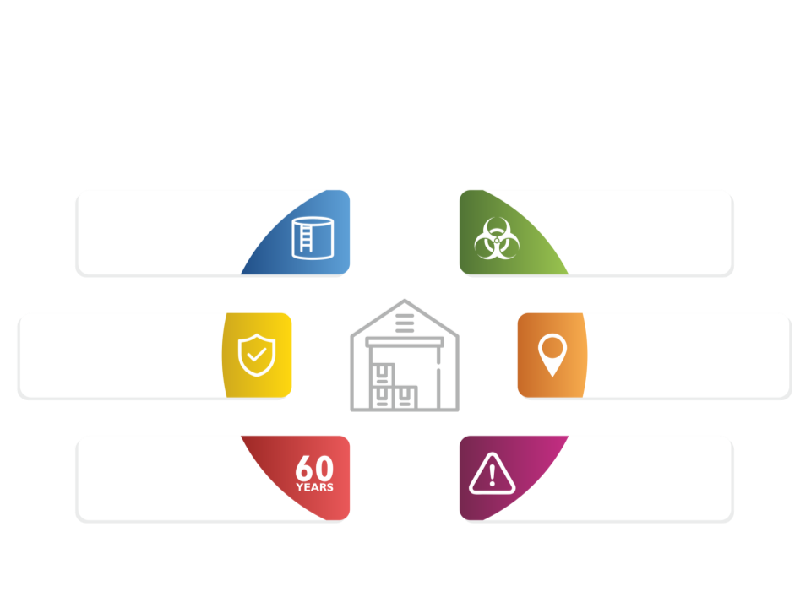
Need of a fully Compliant Chemical Warehouse
Storage of chemicals require specialized handling
Very few options to store the hazardous chemicals with full compliance & standards
Safety - a big concern
Location & parallel services
With 6 decades of expertise in chemicals transportation- our clients have been asking for warehouse solutions too
One of the Perils of the Chemical Industry is that at most instances the service providers do not walk the talk and compromise on standards, this leads to inefficiencies with an inbuilt risk.

Slide 7
A World-class Facility
Built with the state-of-the-art technology, meeting world class standards
Amongst the top warehouses in the country - Fully compliant with NBC 2016 & NFPA
Adhered with thorough and professional fire & safety compliance
International design with strict compatibility for storing chemicals of varied class.

Slide 8
We've got the chemical industry covered
Engineered with high compliance standards to store the below category of hazardous chemicals comfortably and securely. This covers almost 80% of the industry requirement.
Class 2
Class 3
Class 4
Class 5
Flammable Gases
Compustable Liquids
Flammable Solids
Oxidizers
Non-Flammable Gases
Flammable Liquids
Dangerous When Wet
Organic Peroxide
Inhalation Hazards
Spontaneously Combustible
Oxygen
2
Class 6
Class 8
Class 9
Poisons (Toxic)
Corrosives
Miscellaneous
Dangerous
substances
Inhalation Hazard
8

Slide 9
Accommodates every need
Spacious facility with a total area of 2,18,350 Sq. ft to store precious haz-chems in perfect way with utmost safety measures offering complete peace of mind.

Slide 10
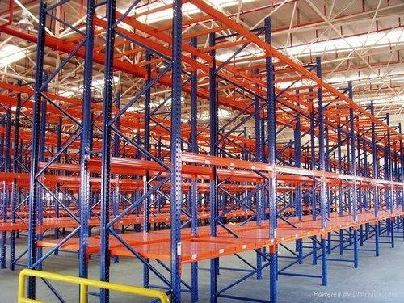
Stored Safely, Securely and Systematically
The racks and shelves are built with heavy duty racking system with systematic arrangement to keep optimum quantity of material with 20,000 pallet positions in G + 7 racking system.

Slide 11
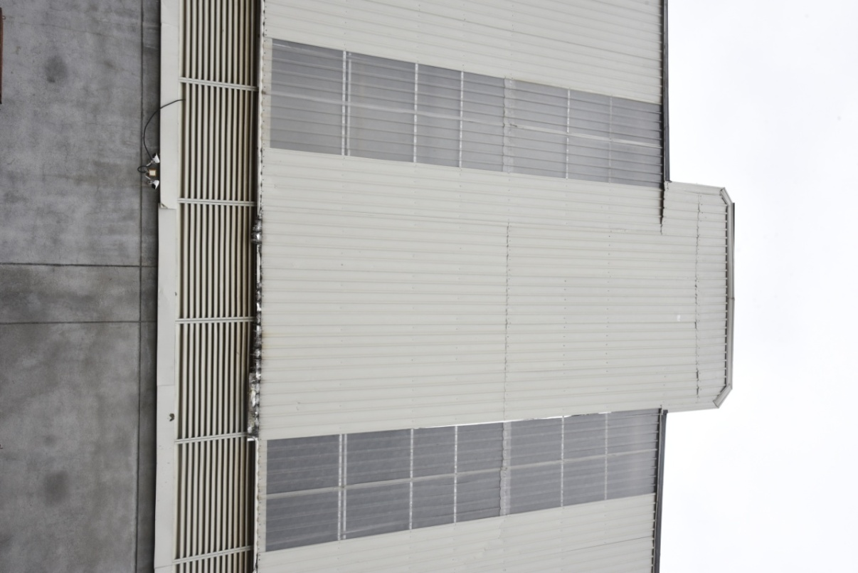
Height for efficiency
46 ft Height
The layout of the warehouse is designed with height of 46 ft at the center efficiently utilizing the space.

Slide 12
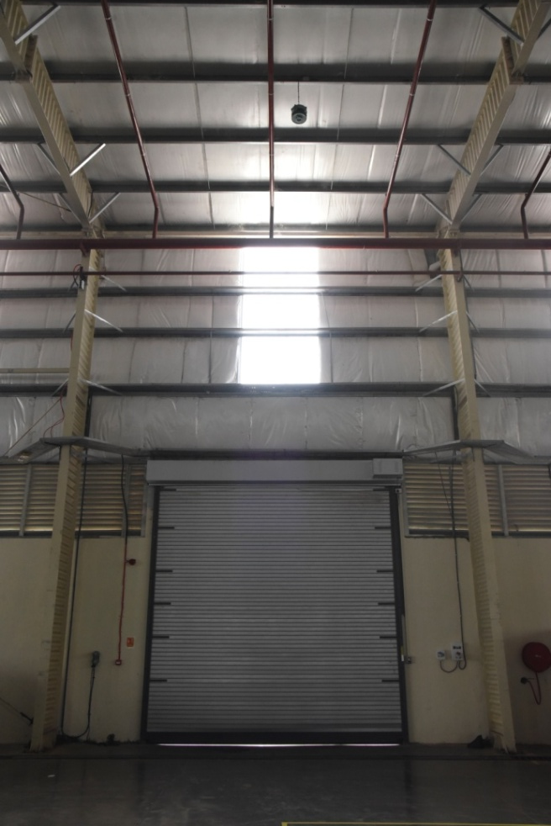
Insulated & Ventilated
Side walls with smart insulation and usage of natural lighting with ventilation
Standing seam roof with 50 mm glass wool insulation on roof and claddings for insulation for stable temperature indoor.
Louvers on side walls for proper ventilation.

Slide 13
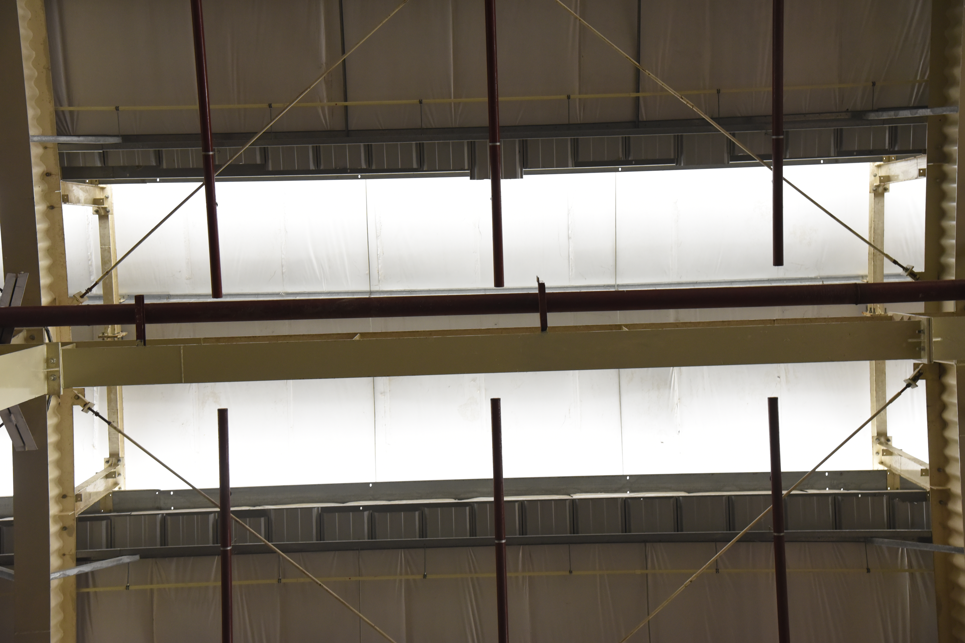
Central Roof Monitoring System
To keep the internal temperature and air in control, central roof monitoring system is in place

Slide 14
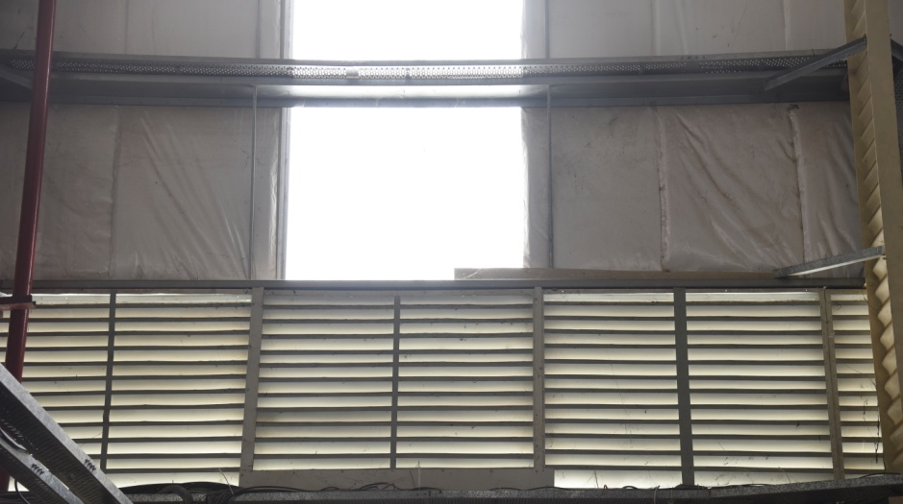
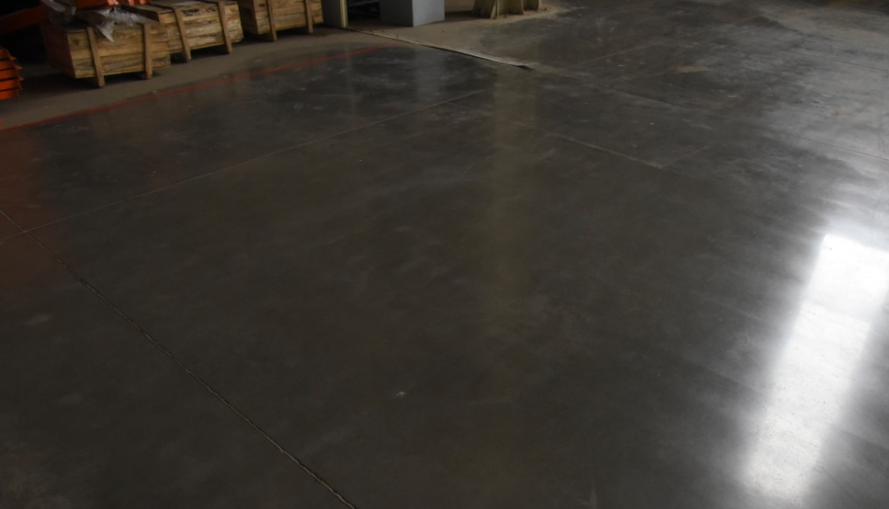
Top to Bottom, Perfect Environment
With the help roof monitoring & louvers 7 air changes Per hour is achieved for ventilation.
FM 2 flooring with Lithium silicate densification having Load bearing strength of 6 tons / Sq. mtr.

Slide 15
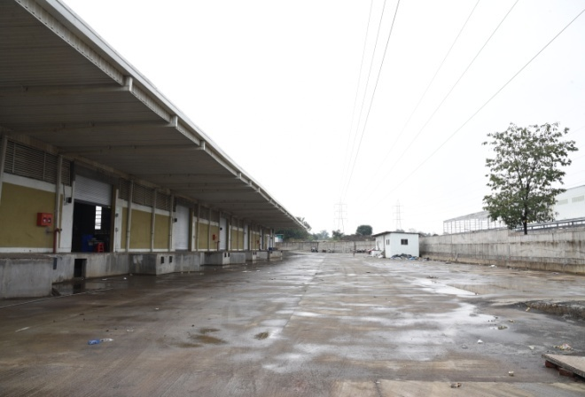
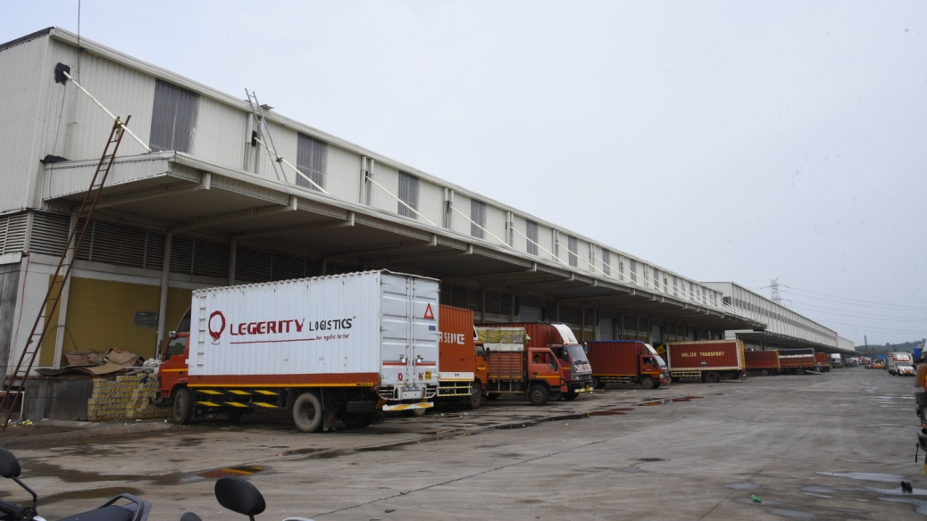
Expansive Peripheral Access
Wider space is provided on all four sides for fire tendering & other vehicles movement.
100 Ft. at the Front and 110 Ft. at Back

Slide 16
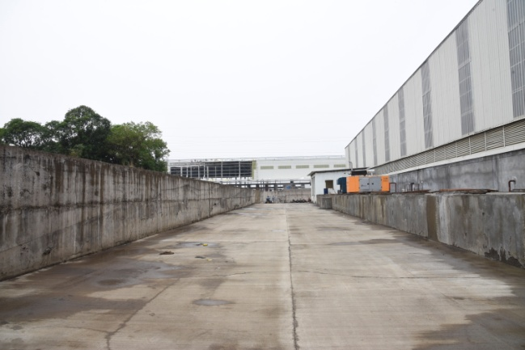
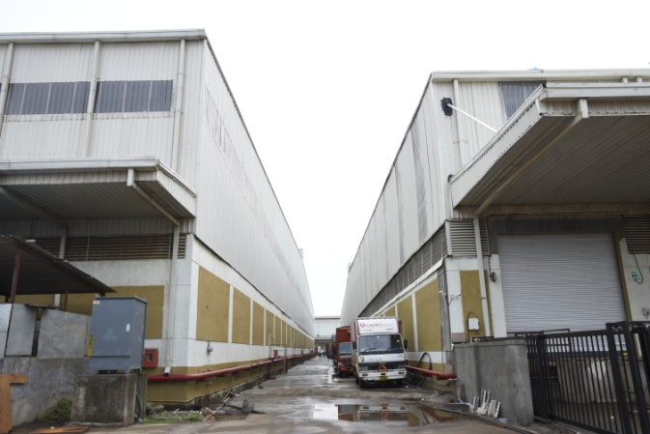
Smooth vehicle movement
On either side there is 32 Ft. RCC road
Parking available for 45 containers

Slide 17
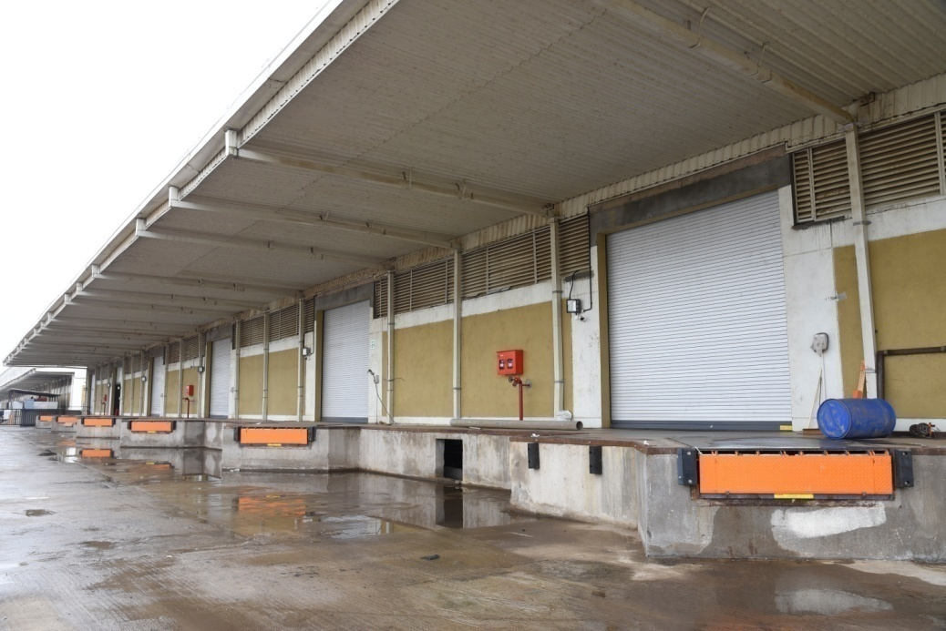
All-Weather Operations
26 ft and 20 ft Canopy throughout on both sides for all-weather smooth operations

Slide 18
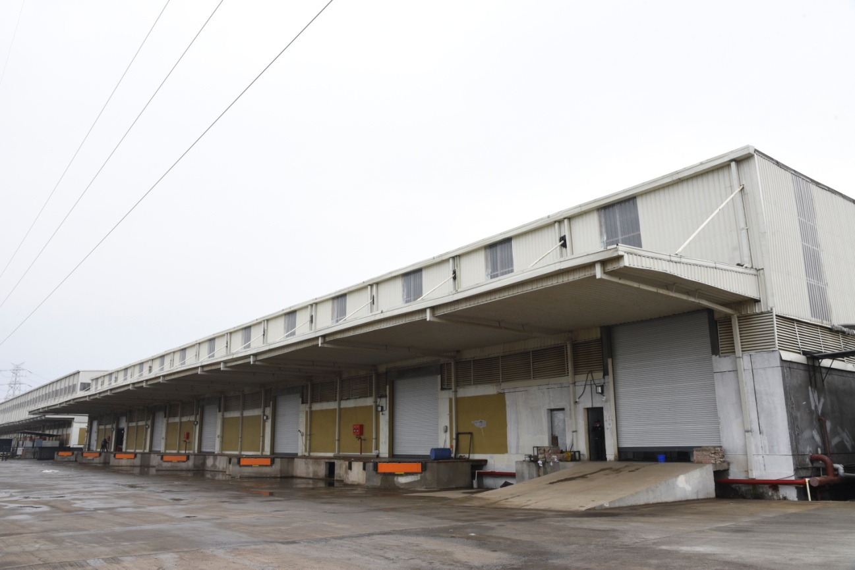
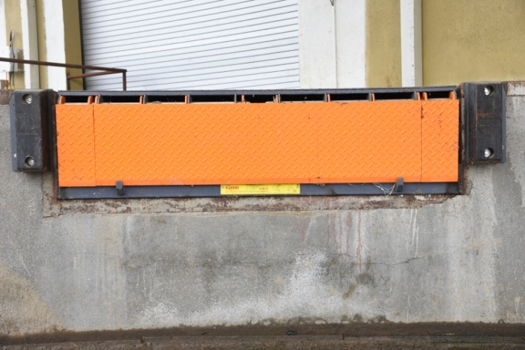
Smooth Loading & Unloading
6 Operating Docks at both sides of 14.8 X 14.8 Ft (Both side operations. Dock levelers at every alternate dock) One additional shutter of 14.8 X 20 Ft. for maintenance purpose

Slide 19
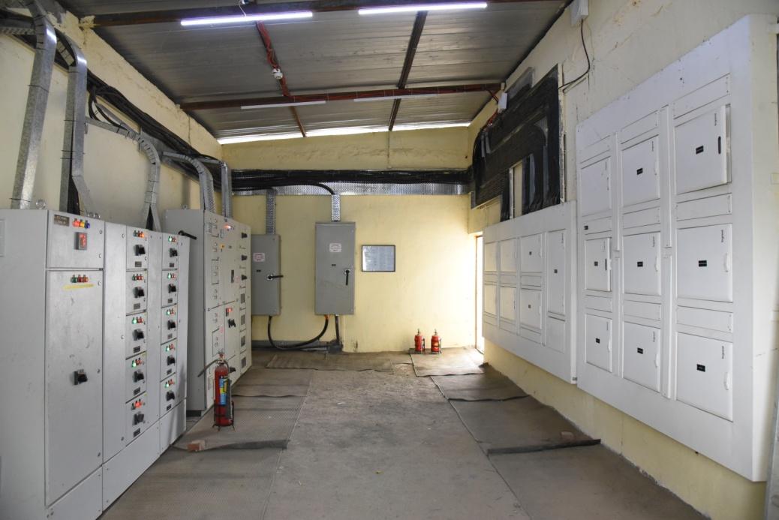
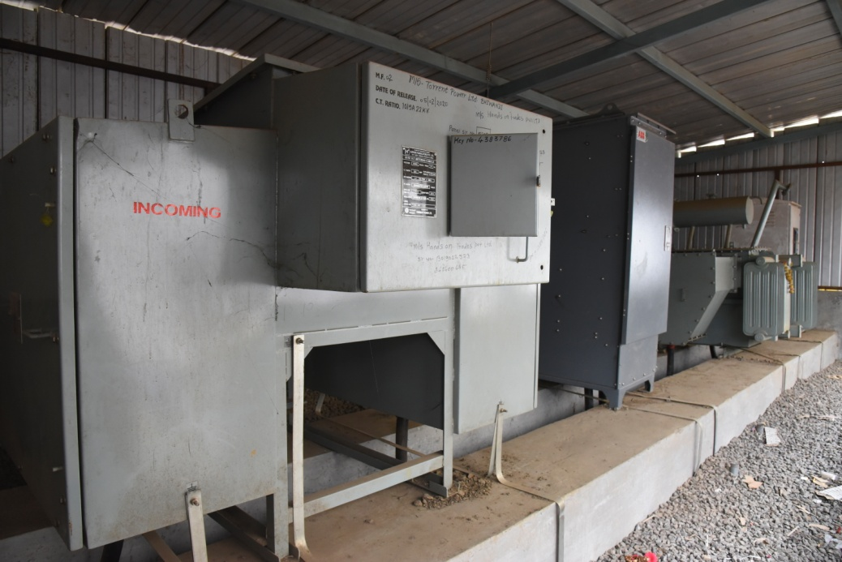
Uninterrupted Power
Electric power system of 315 KVA Transformer & DG back up
for on-site dedicated & continuous power supply.

Slide 20
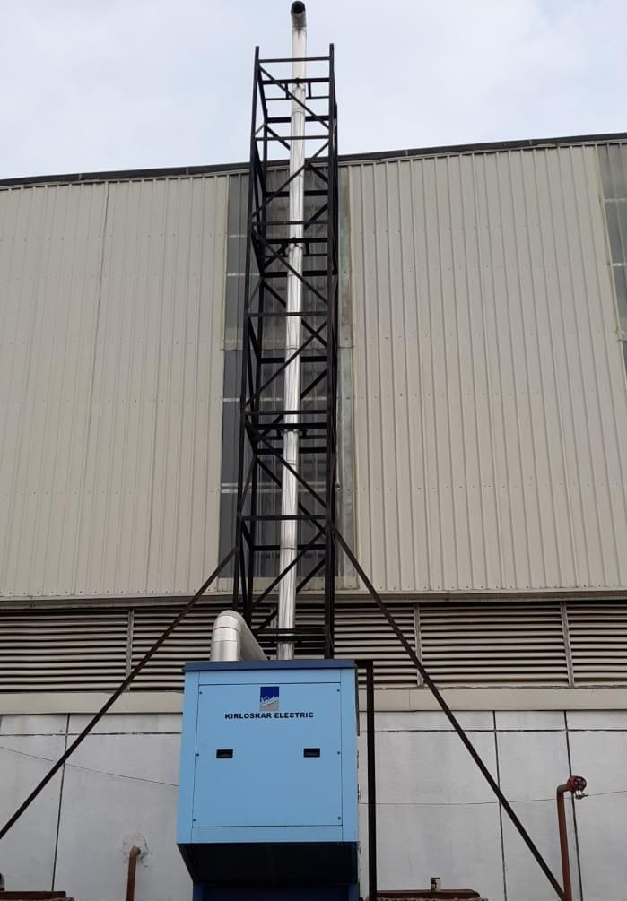
24x7 Power back-up
Back up options for electricity – uninterrupted operations at all the times

Slide 21
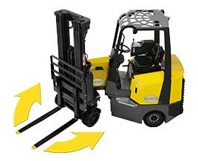
Seamless dock-to-rack Movement
test
Articulated forklift, Battery operated fork lift, Battery operated pallet truck, Hydraulic pallet truck etc.

Slide 22
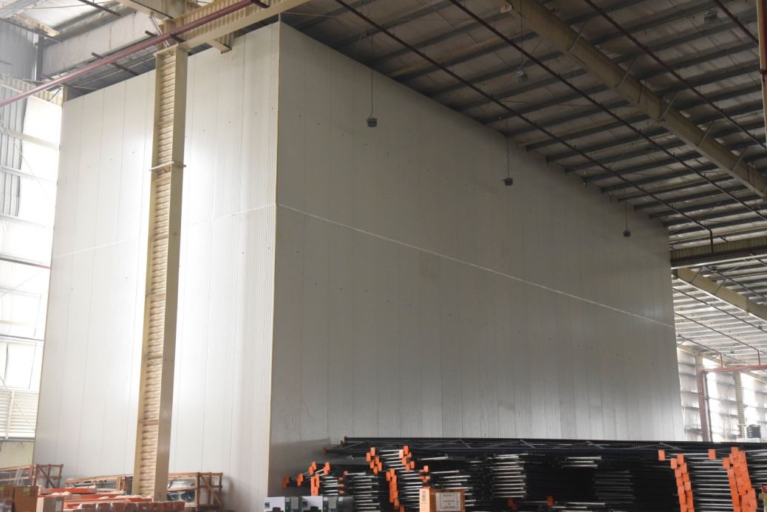
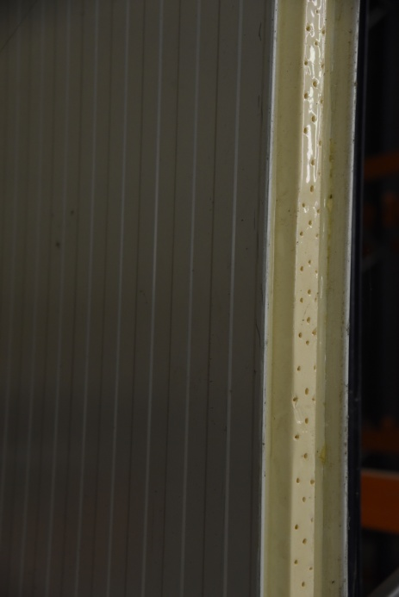
Hyper-customized Chambers Available
Customized chamber for storage with required fire fighting system
Separate dedicated area with HVAC system
Cool room created with PIR Panels

Slide 23
Shrink Wrapping
Stickering
Value added Services and support
Repacking
Lashing & choking
Labeling
Bulk
Break

Slide 24
World-class Features
Warehouse Infrastructure
Features
Details
6 Operating Docks at both sides of 14.8 X 14.8 Ft. (Both side operations. Dock levelers at every alternate dock) One additional shutter of 14.8 X 20 Sq. Ft. for maintenance purpose
Loading & Unloading Docks and Dimensions
Total Warehouse Space
2,18,350 Sq. Ft. – Built up Area 1,74,592 Sq. Ft. – Carpet Area
Heavy Duty racking system
20000 + pallet positions
Canopy
20 Ft. throughout Canopy on both sides
Warehouse Height
Center – 46 Ft.
Side Walls – 36 Ft.
Plinth Height
4 Ft. from ground level of the plot
Type of Roofing
Standing seam roof with 50 mm glass wool insulation on roof & claddings
Electrical power system
Dedicated & continuous power supplies, 315 KVA Transformer & DG back up
Ventilation
Roof to have roof monitor & louvers at the cladding
Latest material handling equipment to support seamless operations
Battery operated fork lift, Battery operated pallet truck, Articulated Fork lift, Hydraulic pallet truck etc.
Flooring Type
FM 2 flooring with Lithium silicate densification having Load bearing strength of 6 tons / Sq.. Mtr.
Cool Room controlled Section
Separate dedicated area with HVAC system
Concrete Road Width – wider space on all four sides for fire tendering & other vehicles movement
100 Ft. on Front, 110 Ft. on Back & 32 Ft. on each side
Customized chamber for storage with required fire fighting system
As per the clients’ requirements

Slide 25
Chem-Store – Floor Layout & Specifications
Space for fire tendering and other
Vehicles movement on all four side
Utility Area
Heavy duty racking system
20000 + pallet systems
Loading & Unloading docks
Emergency exits
Staging Area
Loading & Unloading docks
Built-Up Area – 2,18,350,000 sq. ft.
Carpet Area – 1,74,680 sq. ft.
Office Area – Mezzanine with Open View Concept
Height at Centre – 46 ft. (14 m)
Height at Sides – 36 ft. (10.9 m)
100 ft road on docking side with boundary wall
32 ft wide road on wall and utility area

Slide 26
Highlights of Utility area
Space for fire tendering and other
Vehicles movement on all four side
Utility Area
Emergency exits
Pump Room
Contentment PIT
Water Tank
Electrical Room
Battery Charging area
Transformer room
Cold Room

Slide 27
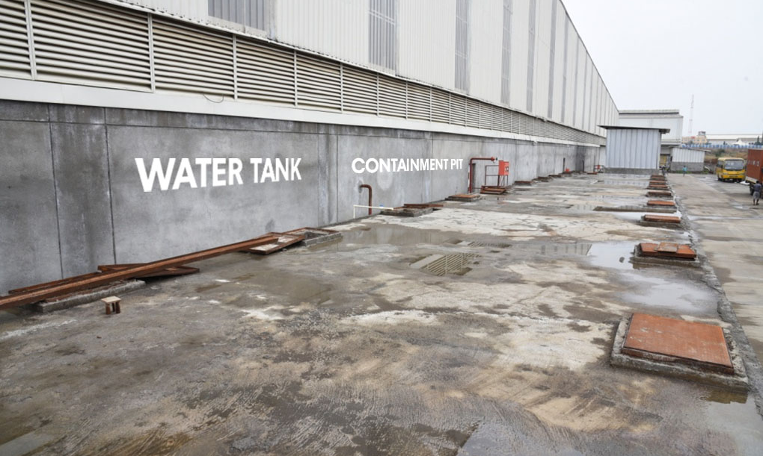
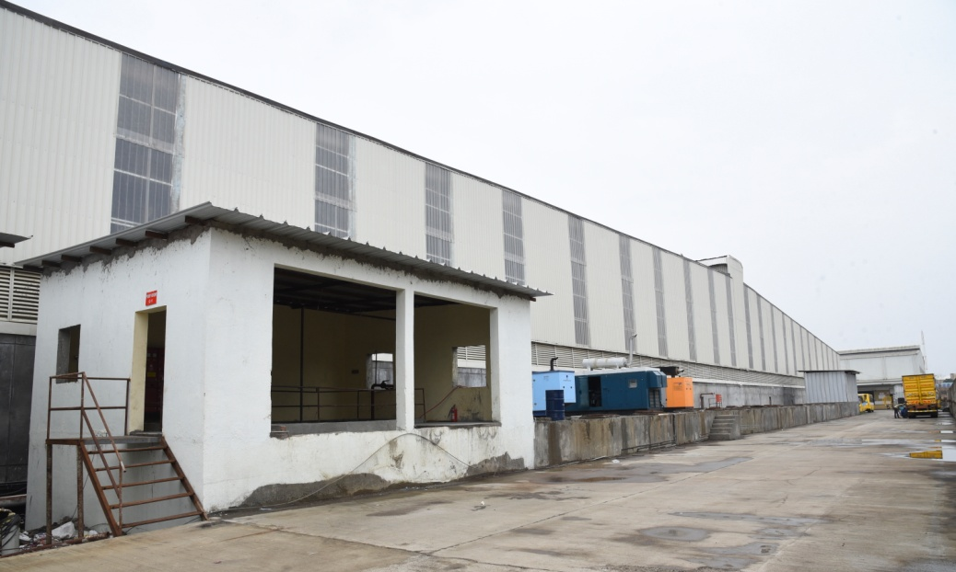
Storage & Spillage Management
Water tank for hydrant & sprinklers. Separate Containment pit
Dedicated tank of 4 Lakh Ltrs.
Dedicated pit of 4 Lakh Ltrs. for collection of spill and standard procedural disposal

Slide 28
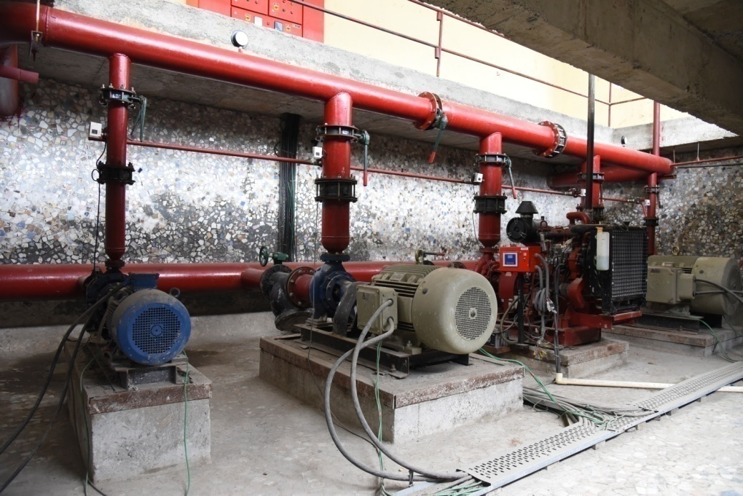
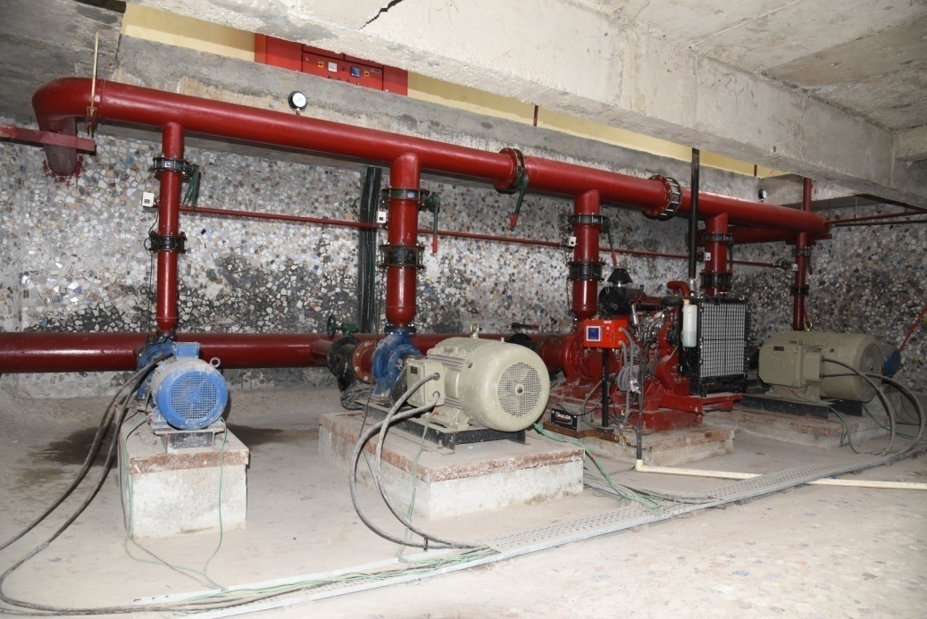
Pump room with positive suction
Designed to utilize the natural pressure and provide water supply with back-up motor
for hydrant & Sprinkler.

Slide 29
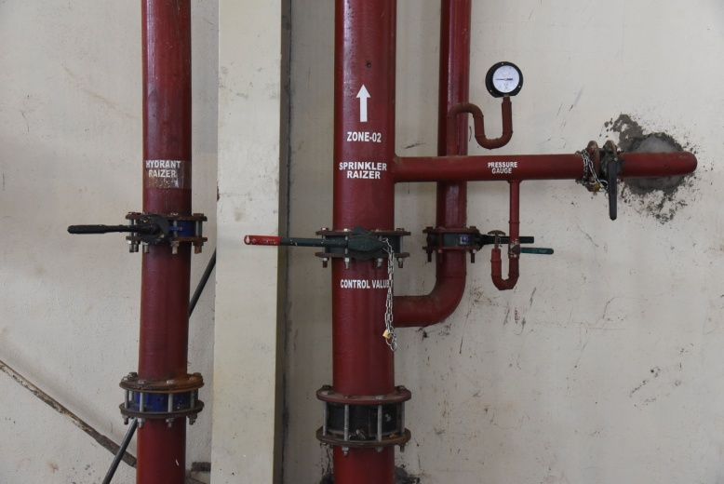
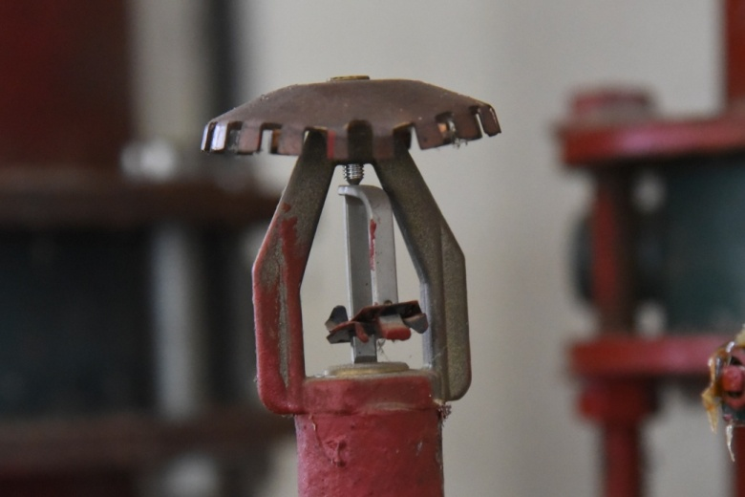
Fire Safe Environment
Fire hydrant & Sprinklers system & Fire detection system and alarm system
Fire Hydrant as per NBC 2016 norms with ESFR sprinklers with K-factor of 25.2 (350 LPM)
Main electrical pump for sprinkler 485 M3 /HR @88 M

Slide 30
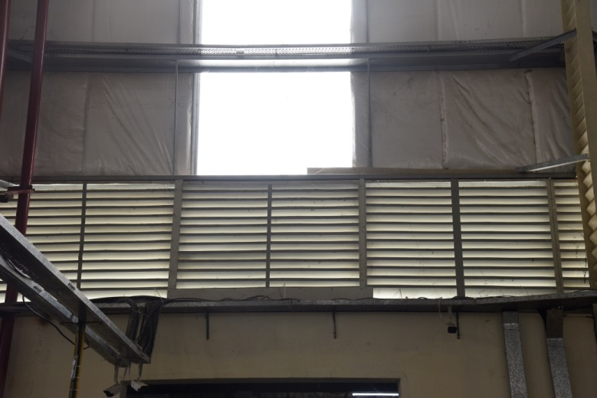
Drencher System
A system which provides a curtain of water for protection against internal and external “exposure” to fire, and/or the protection of large openings.
Bearing in mind, of storage of CHEMICAL products the entire periphery of the site is equipped with the Drencher.

Slide 31
VESDA Fire Detection System
Intelligent smoke / fume detection system – VESDA (Very Early Smoke Detection Apparatus )

Slide 32
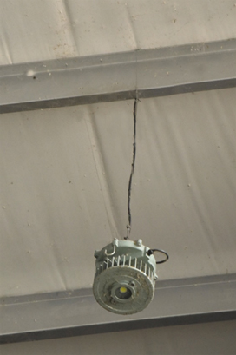
Flame-proof Electrical Fixtures
High-quality flame proof FRLS Cable

Slide 33
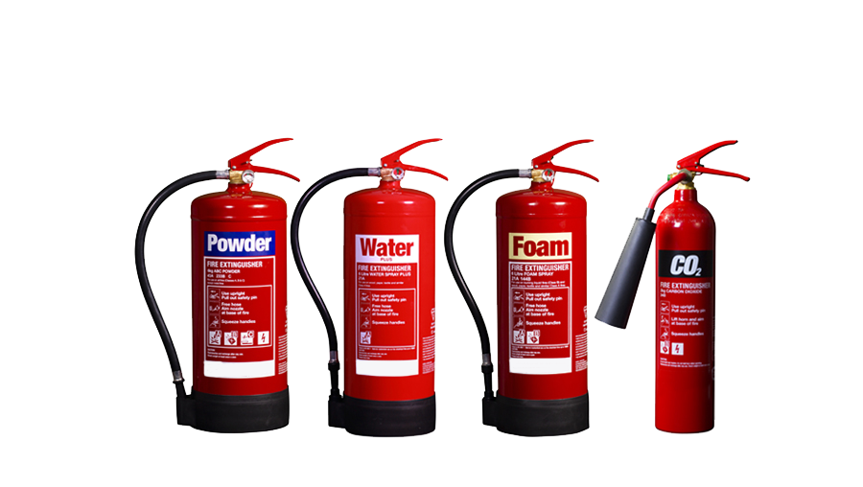
Ready for Every Eventuality
Different kind of fire extinguishers to douse different kinds of chemical and non-chemical fires.
Along with training and fire drills for staff and workers.

Slide 34
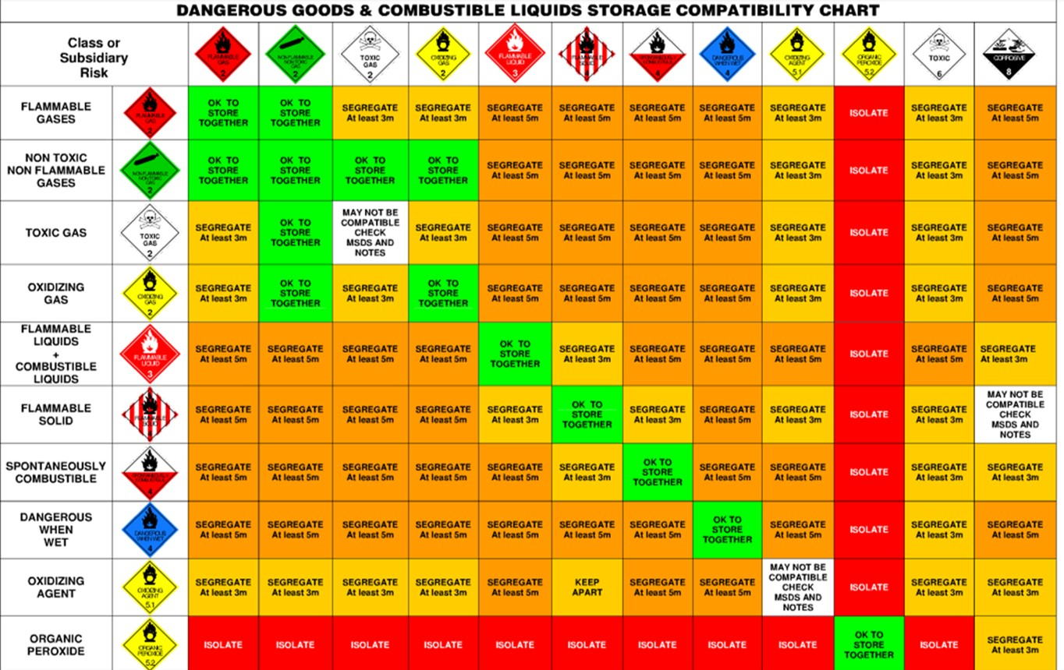
Storage and handling compatibility
Storage compatibility
chart

Slide 35
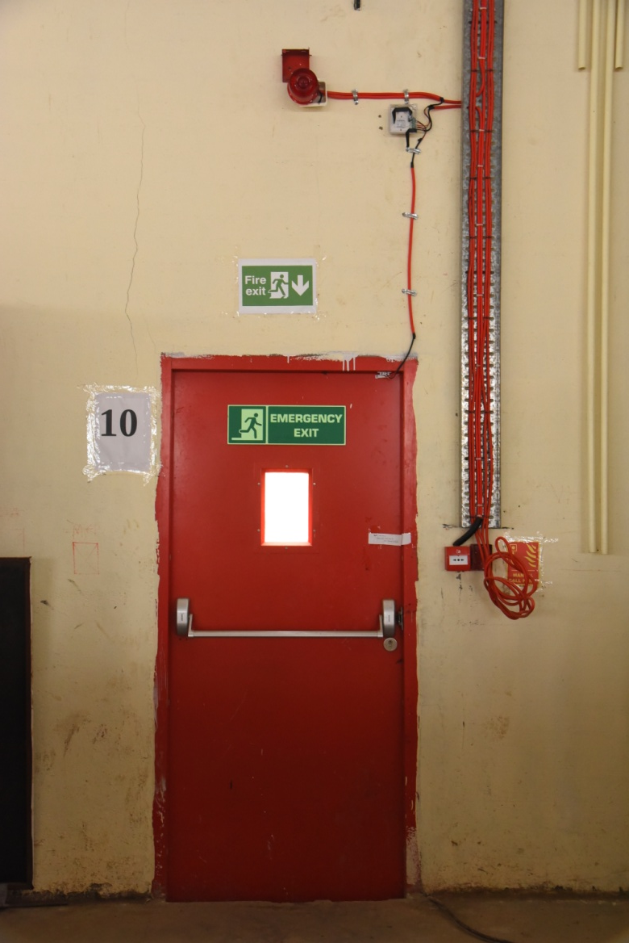
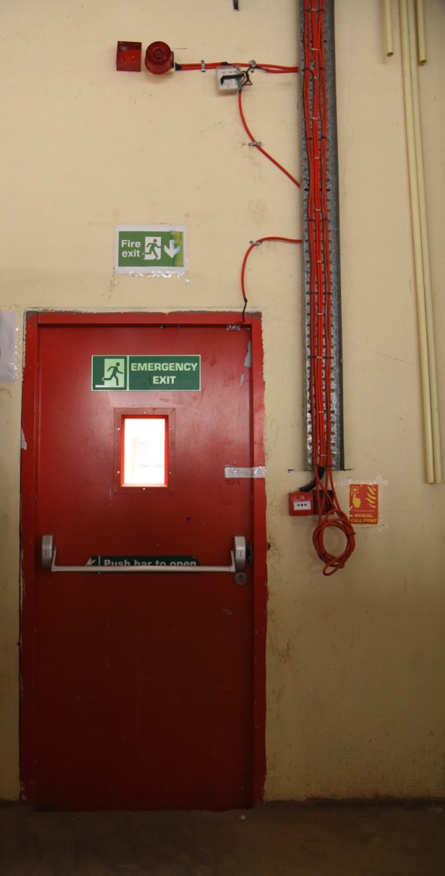
Emergency Exits
6 Doors on both the sides (total 12 doors) at every 70 Ft. distance

Slide 36
LBD Area & Trench
Separate area for controlling breakage, leakage & damage material
Trench along side 4 walls for collection and disposal of material
Size 200 mm wide with slope of 1:300

Slide 37
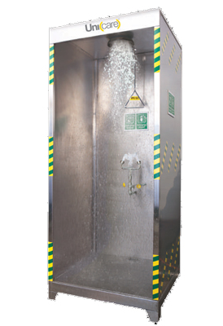
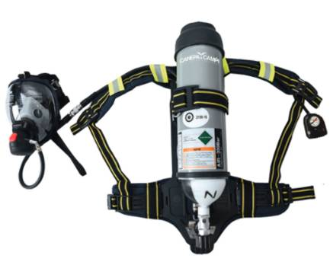
Personal Safety Kit
SCABA
Self-contained breathing apparatus
PPE Kit
Eye washer & Full body washer

Slide 38
Emergency Preparedness
Emergency Response & Disaster Plan Management
Documentation Procedure plan
Training for personnel
Regular mock and fire-drills

Slide 39
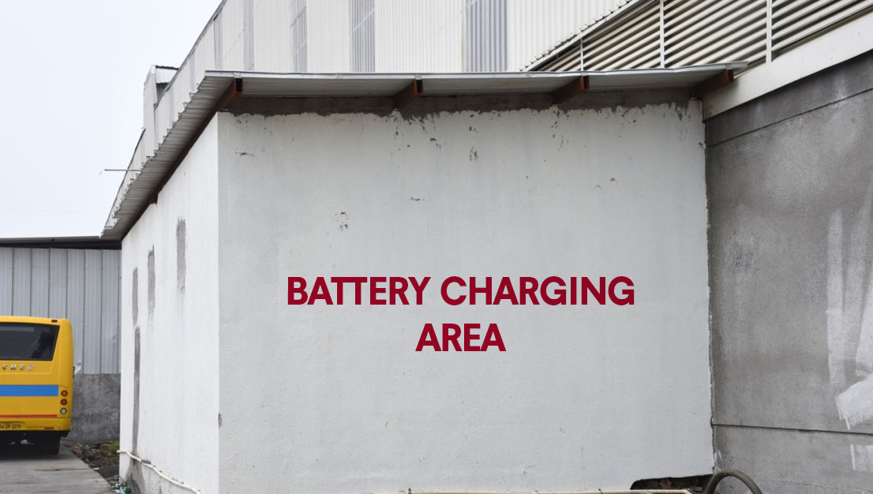
Fully Charged
Separate battery charging area for MHEs with flame proof fittings.
Kept outside the warehouse for safety.

Slide 40
Fire & Safety Features
Features
Details
Water tank for hydrant
and sprinklers
Dedicated tank of 4 LAKH Ltrs.
Lightening arrestors with earthing pit
2 arrestors (grid type) with earthing pit
Containment pit
Dedicated pit of 4 LAKH Ltrs. for collection of spill and standard procedural disposal
Storage and handling compatibility
As per storage compatibility chart
Fire hydrant &
Sprinklers system
Fire Hydrant as per NBC 2016 norms with ESFR sprinklers with K factor of 25.2 (320 LPM
Emergency exits
Doors on both the sides at every 70 Ft. distance
Drencher System
Water curtain on walls in case of any eventuality
On all 4 corners of size 200 mm wide with slope of 1:300
Fire detection system and alarm system
VESDA Fire detection system
Trench
Separate area for controlling
breakage, leakage & damage
YES
Fire extinguisher
Water, Chemical, Powder & Foam-based
ERDPM
Emergency Response Disaster Plan Management
Well trained and skilled
manpower
With support of continuous
trainings & mock drills
Exposure control
Eye washer & Full body washer
Flame proof lighting &
Cabling
FRLS Cable
Battery charging
Separate battery area for MHE's
Use of PPE during handling
PPE such as masks, gloves, caps, respirators, face shield etc.

Slide 41
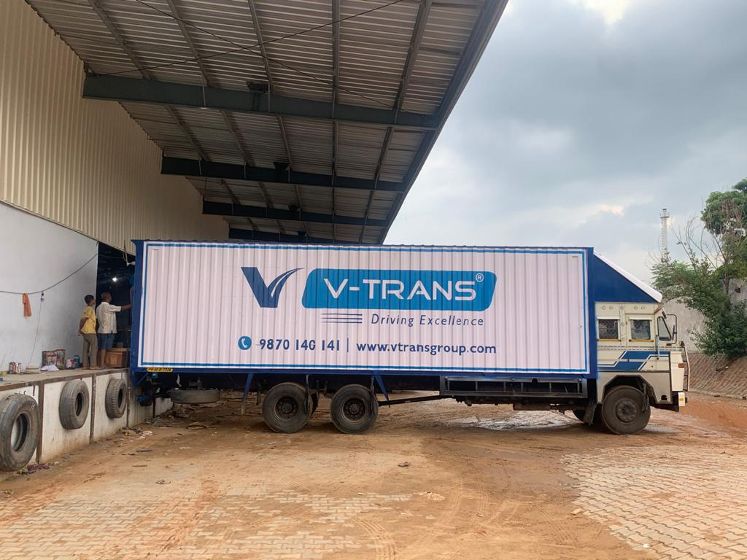
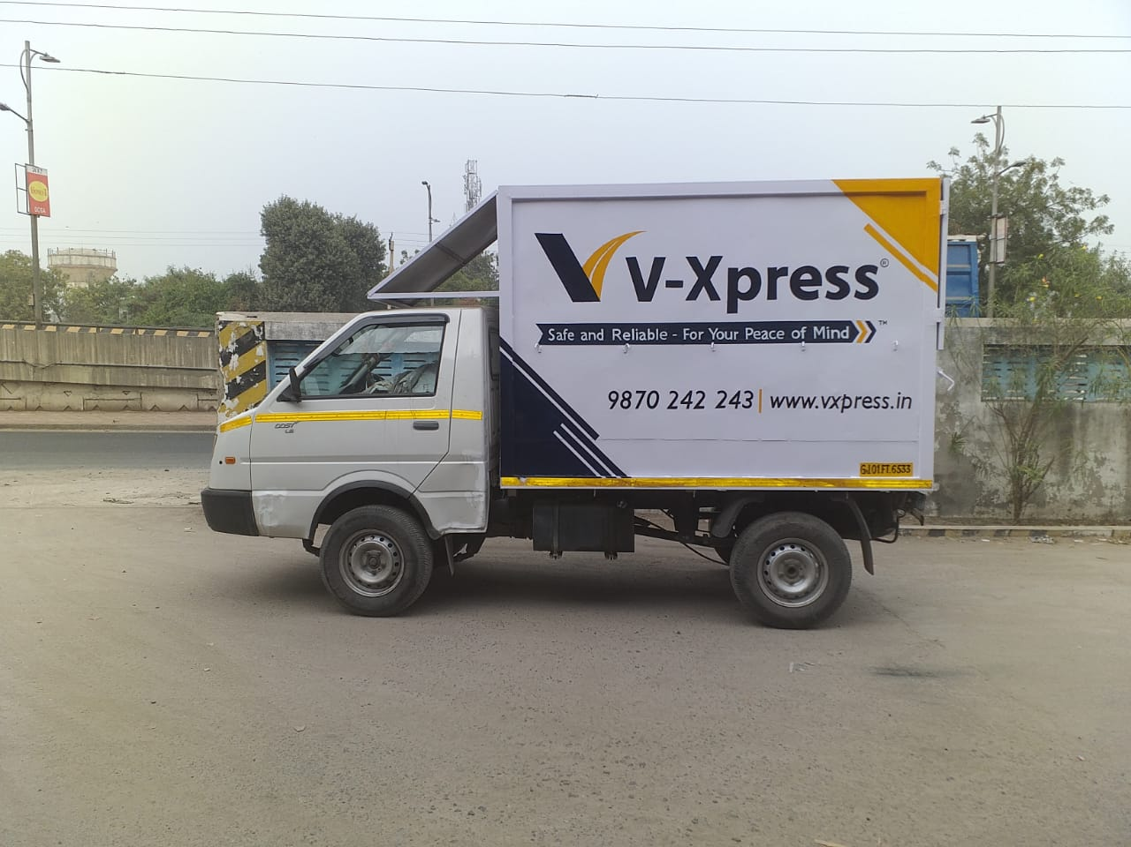
Edge of Transportation
V-Trans & V-Xpress have a branch at the facility.
Provide primary transportation from JNPT to Chem Store facility
Local distribution from Chem Store to your nominated transport in Bhiwandi & around.
Pan-India transportation from Chem Store thru V-Trans, V-Xpress or other associates

Slide 42
Compliances
NBC 2016
Fire safety requirements, structural design and construction as per National Building Code 2016
NFPA
Fire fighting systems as per various NFPA (National Fire Protection Association) codes – NFPA 13, NFPA 14, NFPA 20, NFPA 30, NFPA 72
IS 15105 & OISD STD 114
Compliances
Related to Fire system and safe handling of hazardous material
Permission from designated
authorities to store chemicals
Gram Panchayat NOC,
FIRE NOC from Maharashtra State Govt.
CTE & CTO
Granting of Consent to Establish & Consent to Operate from MPCB

Slide 43
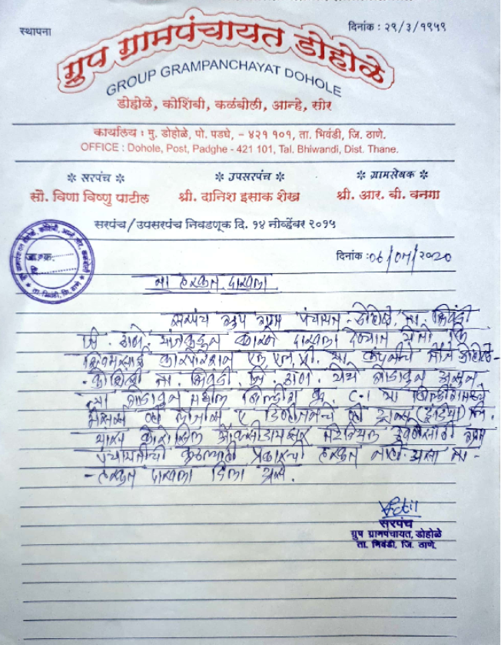
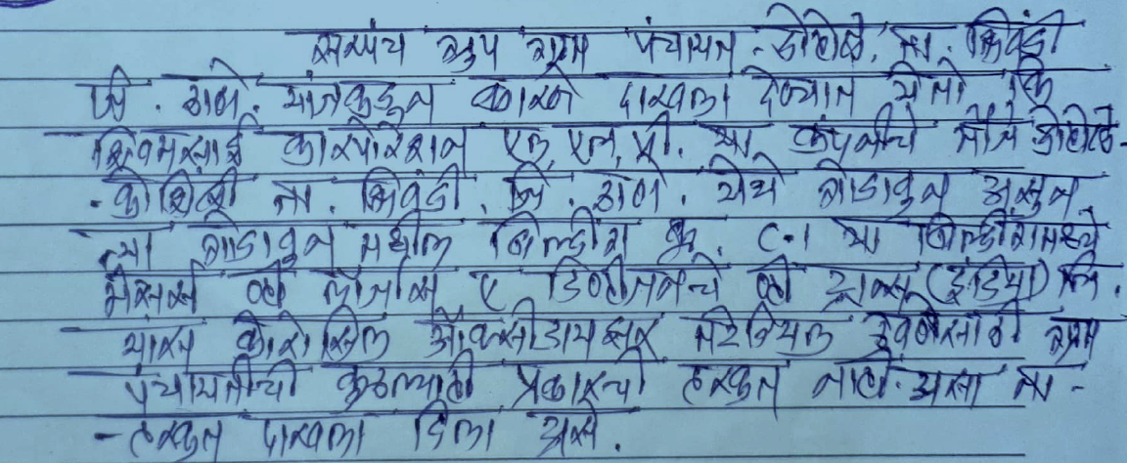
NOC From Gram Panchayat

Slide 44
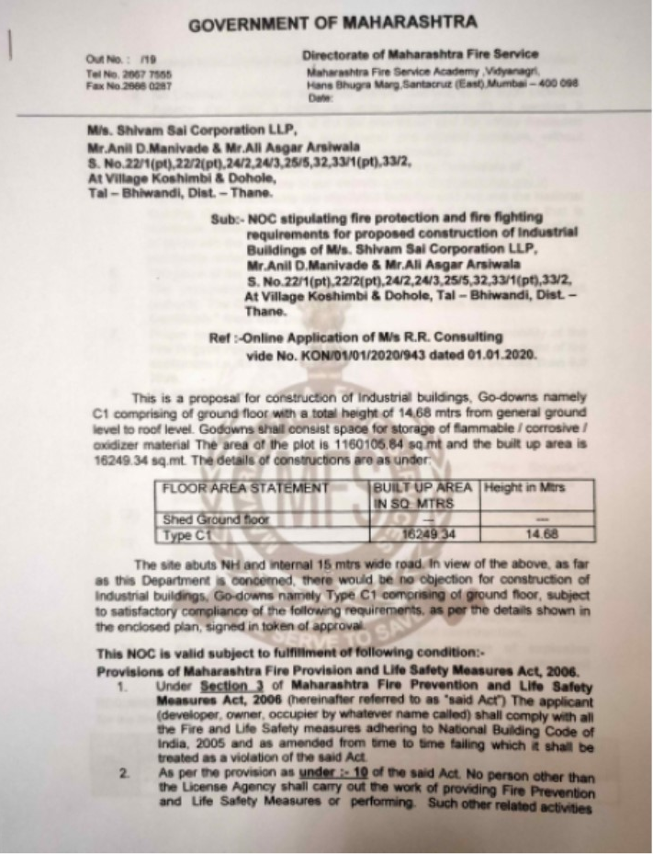
Provisional Fire NOC

Slide 45
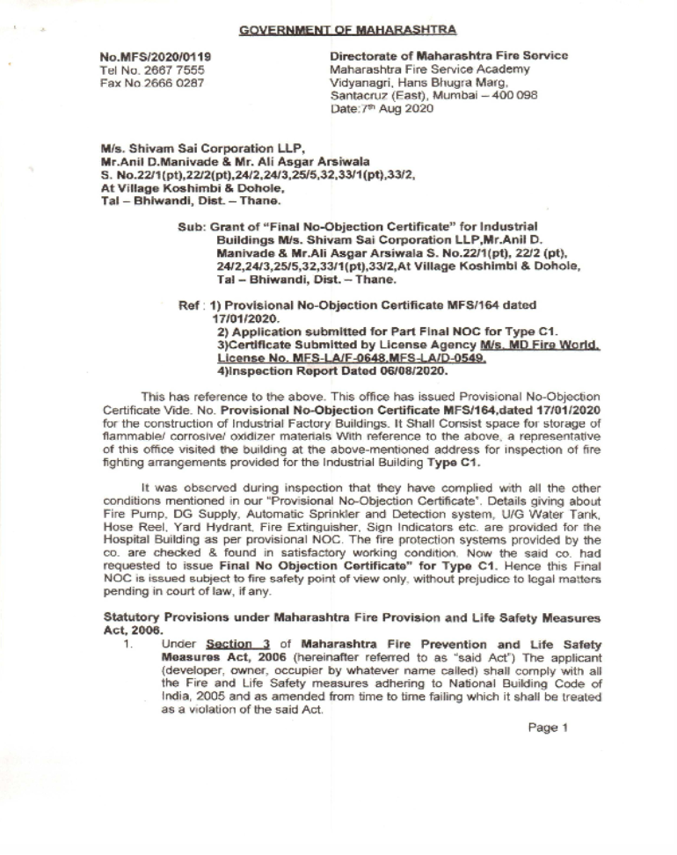
Final Fire NOC

Slide 46
Build-to-suit Facility
Needs of our customers are paramount, customization / scalability /flexibility are the need of the hour.
We have factored in build-to-suit concept in order to come up with perfect and accurate solutions tailor-made for each of our customers.
Tell us your specific requirements for your precious chemicals, and we will customise an area just for your needs. A perfect solution.

Slide 47
Manpower Development
Dedicated HSSE Officer for Chem Store site
Conducting mock fire drills and emergency situations
Specific safety briefings to all levels of staff
Checklists for various aspects ex - MHEs, Fire fighting equipment's, racks, inventory, etc.
UNLOADING/ LOADING
STACKER
USE OF FIRE- EXTINGUISHER
FORKLIFT
SPILL KIT
Regular training sessions on various topics covering safety, know-how, operational matters

Slide 48
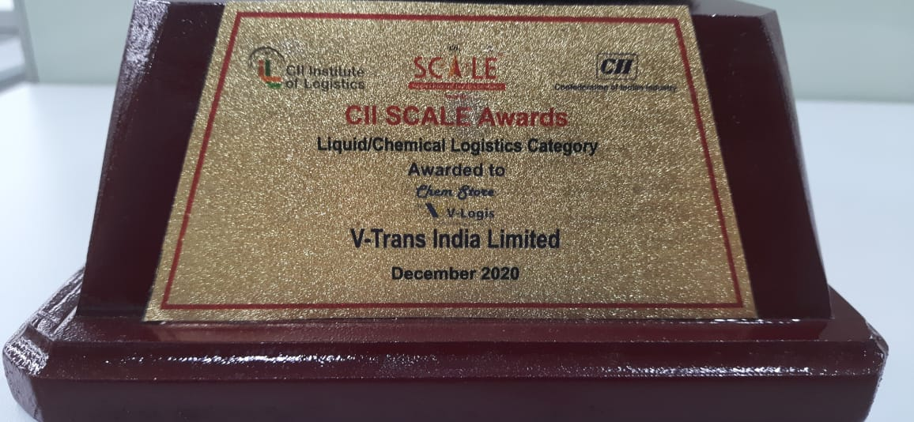
Accolade for excellence
Though we are yet to start officially however the industry has recognized the highest level of safety standers and best in class infrastructure and awarded the excellence.

Slide 49
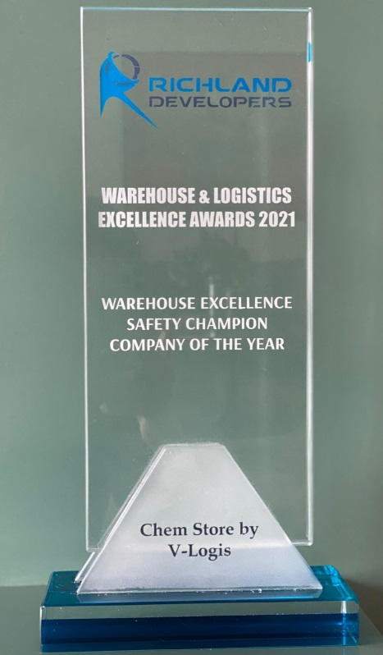
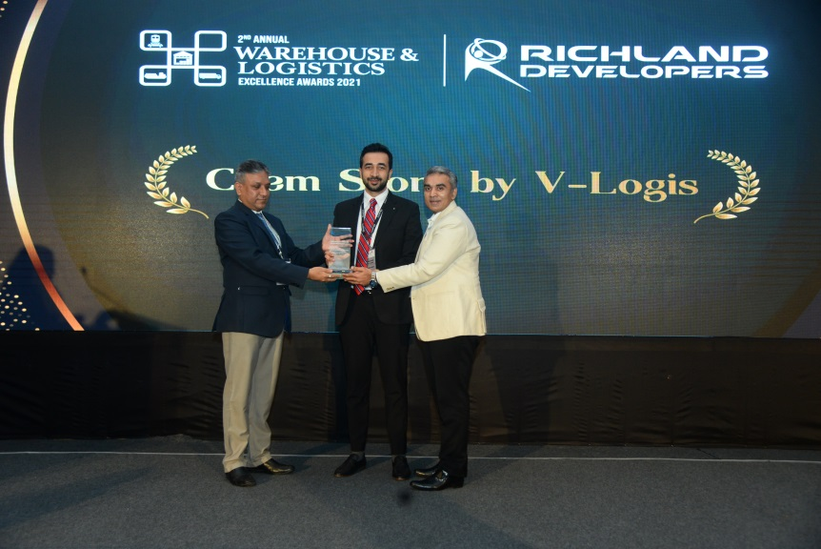
Accolade for excellence
When it comes to safety - what can be better than Chem Store - We are pleased to share that Chem Store is the Winner of 2ND ANNUAL WAREHOUSE & LOGISTICS EXCELLENCE AWARDS 2021 for Safety Champion Company of the Year for the category Warehouse Excellence.

Slide 50
Let us understand if you need anything more
V-Logis, Plot No C1,Sai-Dham logistic Park, Opp. Mata Vishnodevi temple, Next to Indian Oil Petrol Pump, Village Dohale, Taluka Bhiwandi, Dist. Thane.
(Mumbai Nasik -NH -3 Highway. 3 km from Padghaga toll naka towards Nasik)
For more details contact Mr. Sujit Khakale - Head Chem Store +91-7304975400, sujitkhakale@vlogis.in

